Slide 1
Sales performance dashboard
Prepared by KUNGUMAYEE M

Slide 2
Project Overview
Project Objective
The objective of this project is to design an interactive Power BI dashboard that analyzes sales performance using business intelligence techniques.
Objectives
Analyze sales performance using KPIs.
Track monthly sales trends.
Compare sales across regions, categories, and customer segments.
Provide interactive filtering using slicers.
Support business decision-making through data visualization.
Tools Used:
Power BI Desktop
Microsoft Excel (CSV Dataset)

Slide 3
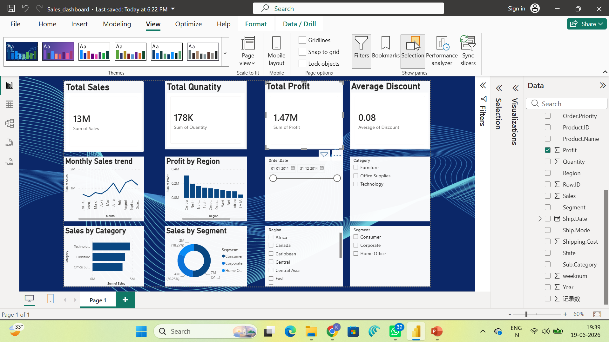
Dashboard Overview

Slide 4
Dashboard Features
Visualizations Included
KPI Cards
Total Sales
Total Profit
Total Quantity
Average Discount
Charts
Monthly Sales Trend (Line Chart)
Sales by Category (Bar Chart)
Profit by Region (Column Chart)
Sales by Segment (Donut Chart)
Interactive Slicers
Order Date
Region
Category
Segment
Time-Series Analysis
The Monthly Sales Trend line chart analyzes sales over time, enabling users to identify growth patterns, seasonal trends, and fluctuations in sales performance.

Slide 5
Business Insights
Insights from the Dashboard
Sales Performance
Total sales reached approximately 13 million.
Total profit generated was approximately 1.47 million.
Category Analysis
Technology category generated the highest sales.
Office Supplies and Furniture followed in sales contribution.
Regional Analysis
Profit varies significantly across different regions.
Regional comparison helps identify high-performing markets.
Customer Segment Analysis
Consumer segment contributes the highest sales.
Corporate and Home Office segments also contribute significantly.
Time-Series Analysis
Monthly sales trends reveal fluctuations throughout the year.
The visualization helps identify peak sales periods and seasonal demand.

Slide 6
Conclusion
Conclusion
This project demonstrates how Power BI can transform raw sales data into meaningful business insights.
Key Achievements
Designed an interactive dashboard.
Implemented KPI cards for business metrics.
Performed time-series analysis using monthly sales trends.
Used interactive slicers for dynamic filtering.
Developed charts to compare sales, profit, regions, categories, and customer segments.
Benefits
Enables faster decision-making.
Improves sales performance analysis.
Supports interactive exploration of business data.

Slide 7
Thank You

